Slide 1
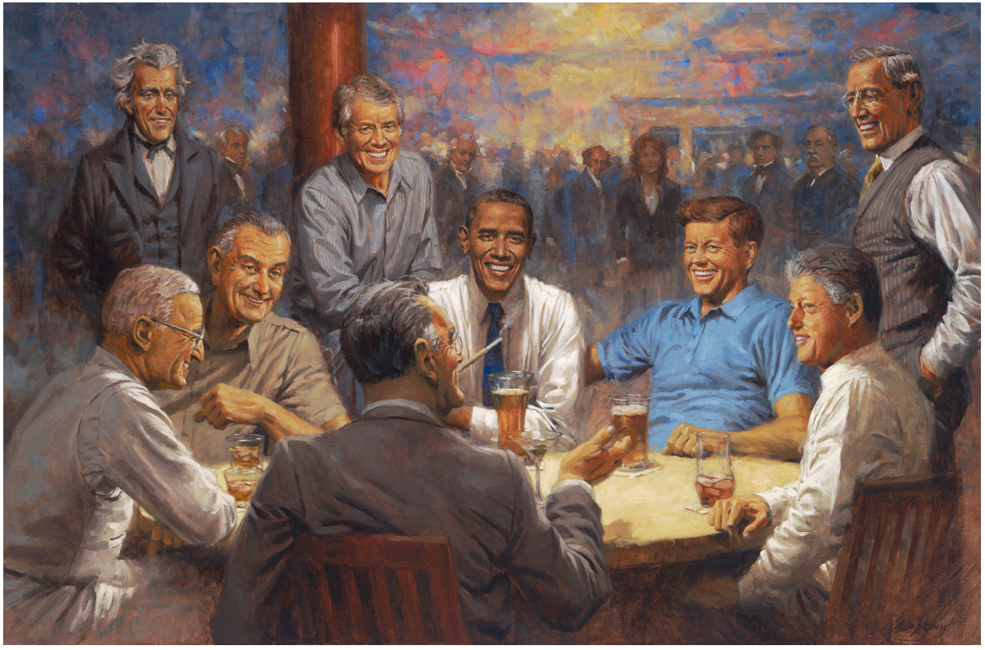
The Democratic President’s Club

Slide 2
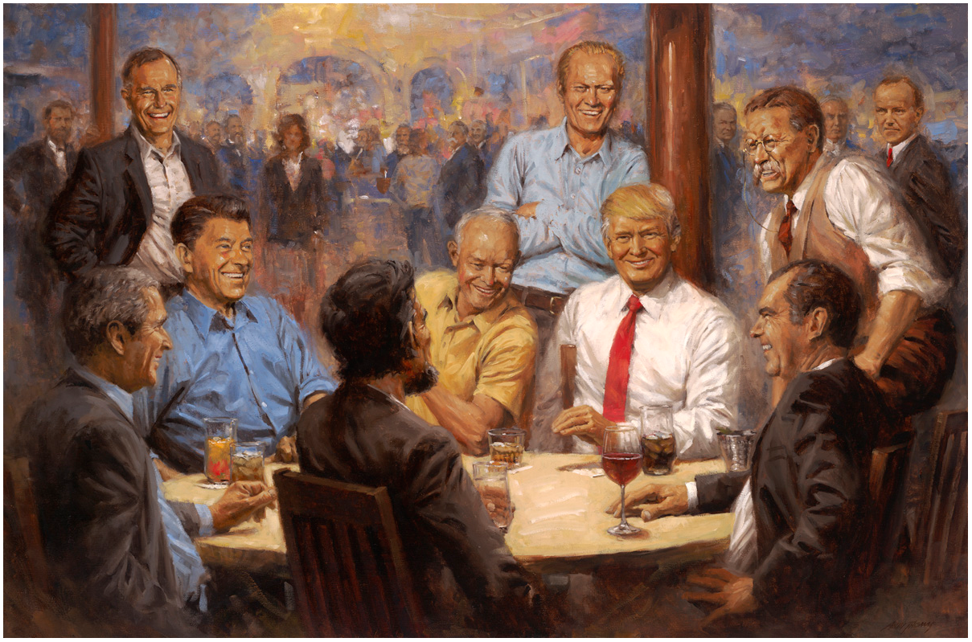
The Republican President’s Club

